Slide 1
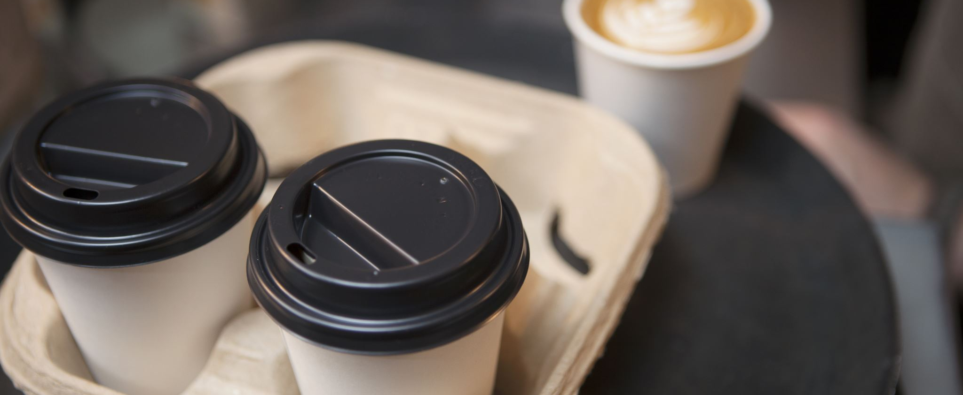
Online Food Ordering System

Slide 2
Online Food Ordering System
Team Members:
Muhammed Ali Muhammed
Muhammed Fathi Salah
Mustafa Mahmoud Mustafa
Mahmoud Muhammed Abdelwehab
Muhammed Hani Abo Elela
Supervised By:
Dr. Abdel Wahab Kamel Asammak

Slide 3
Business Objectives
1.1 System Scope:
The goal of the system is providing online food ordering service to save time and effort of users with easy user interface that encourage them to purchase.

Slide 4
System Requirements (Cont.)
1.2 Business Objectives:
Our project covers a wide scope designed to implement computerized system for the following Requirements:
Functional Requirements:
Order entry subsystem
Create new order
Add item to cart
Update cart
Look up for meal

Slide 5
System Requirements (Cont.)
Order state subsystem
Check order state
Update order state
Cancel order
Update order
Administration subsystem
Add meal
Update meal description
Delete meal
Add new offer
Create monthly summary reports for sales

Slide 6
System Requirements (Cont.)
Customer maintenance subsystem
Create account
Add meal feedback

Slide 7
System Requirements (Cont.)
Nonfunctional Requirements:
Easy user interface
Little failure rate
Several recovery method and data backups
High response time
Secured access control
High performance servers

Slide 8

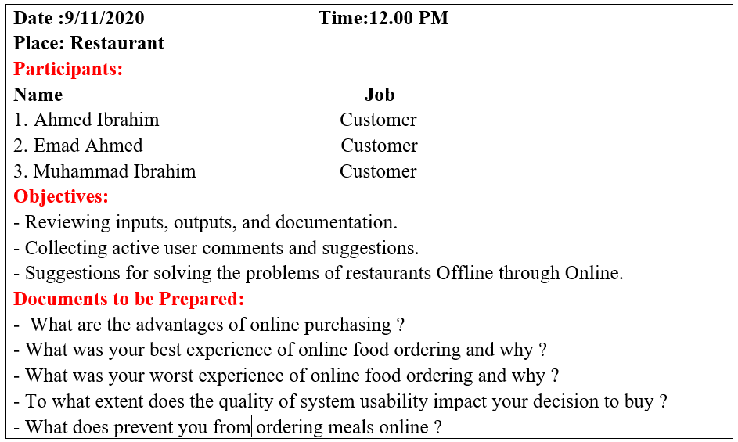
System Requirements (Cont.)
Interview Agenda
1.3 Fact Finding: Interviews

Slide 9
System Requirements (Cont.)
Interview Summary:
According to customer opinions we reached to that :
Online ordering saves their time and effort.
They can compare various products and prices.
Examples for good experiences of online food ordering Systems.
The effect of easy user-interface systems on purchasing decision.
Examples for bad experiences of online food ordering systems.

Slide 10
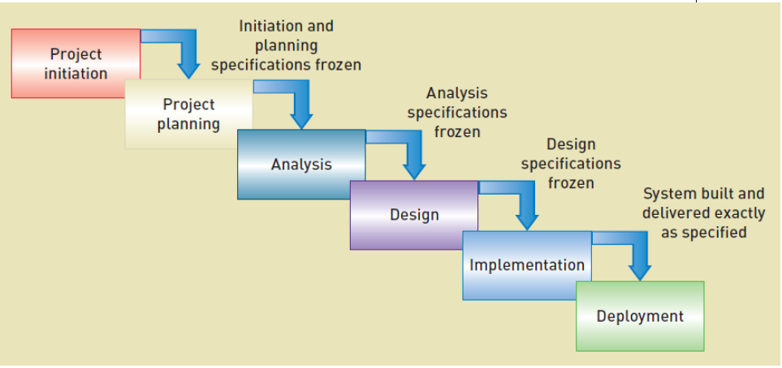
System Requirements (Cont.)
1.4 Development Process:
We decided to apply the Iterative development technique.
The reason for using this technique is that it Assumes the project must be more flexible and adapt to changing needs as the project progresses and Requirements and needs are uncertain and/or high technical risk

Slide 11
System Analysis
2.1 Used Methodology:
Object-Oriented approach

Slide 12
2.2 Analysis Models: Event Table
Event | Trigger | Source | Use case | Response | Destination
Customer creates account | Customer details | Customer | Create new account | Account ID | Customer
Customer creates new order | Customer account credentials | Customer | Create new order | Order summary | Customer
Customer checks order state | Customer information Order summary | Customer | Check order state | Order state | Customer
Customer updates order | - Order ID - Order state | Customer | Update order | New order summary | Customer
Customer updates order state | Order ID | - Customer - Chief - Delivery worker | Update order state | Confirmation for updating | Customer
Customer cancels order | - Order state - Order ID | Customer | Cancel order | Canceling confirmation | - Customer - Delivery worker - Chief
Customer searches for a meal | Meal name | Customer | Look up for a meal | Meal information | Customer

Slide 13
2.2 Analysis Models: Event Table
Event | Trigger | Source | Use case | Response | Destination
Customer gives feedback for a meal | Customer account credentials | Customer | Add meal feedback | Feedback report | - Customer - Administrator
Administrator adds a new meal | - Meal name - Meal picture - Meal description | Administrator | Add new meal | Meal ID | - Administrator - Customer
Administrator updates meal | Meal ID | Administrator | Update meal description | Meal details | - Administrator - Customer
Administrator deletes a meal from the system | Meal ID | Administrator | Delete meal | Delete Confirmation | Administrator
Administrator adds new offer for a meal | Offer details | Administrator | Add new offer | Start and end time of offer | Customer
Customer adds item to cart | Item name | Customer | Add item to cart | Adding confirmation | Customer
Customer updates cart | Cart content details | Customer | Update cart | Cart content summary | Customer
Time to create monthly summary reports for sales | End of month |  | Create monthly Summary reports | Sales summary reports | Management

Slide 14
Use Case Diagrams

Slide 15
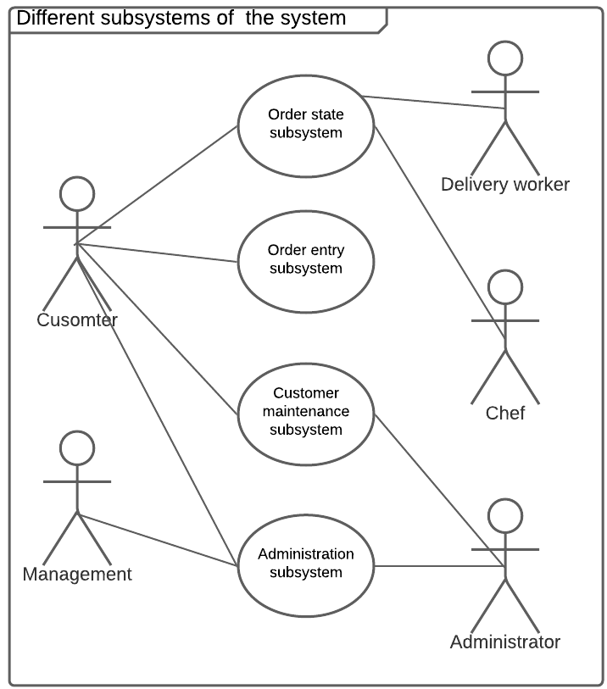
Different subsystems of the system

Slide 16
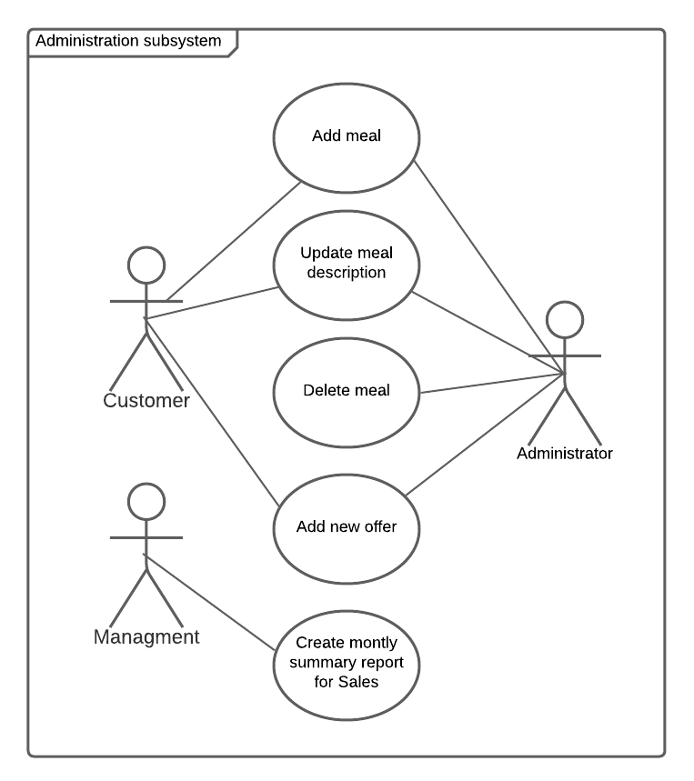
Administration subsystem use cases

Slide 17
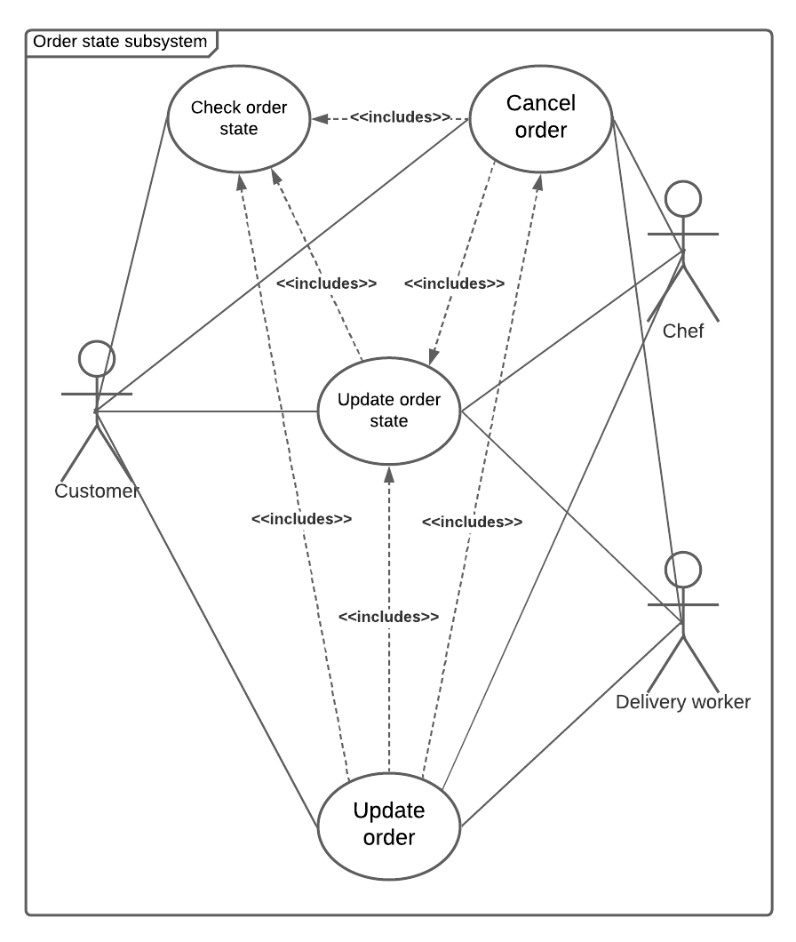
Order state subsystem use cases

Slide 18
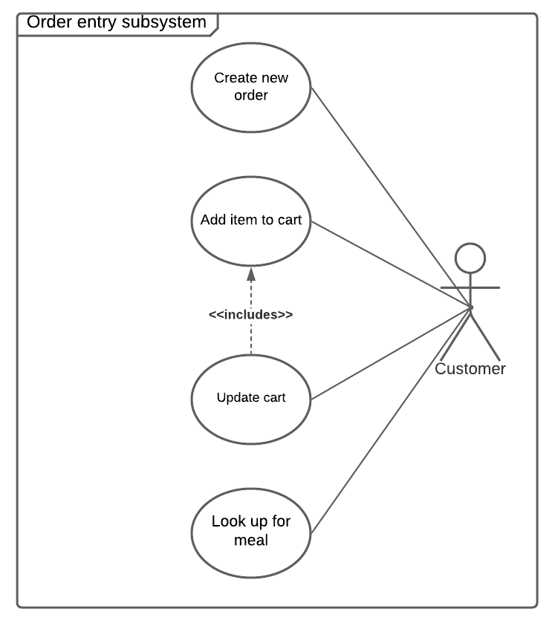
Order entry subsystem use cases

Slide 19
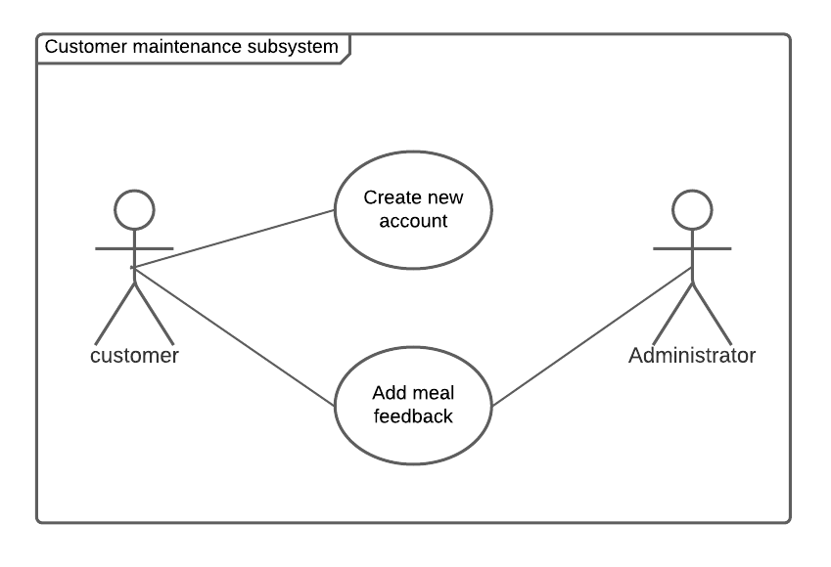
Customer maintenance subsystem use cases

Slide 20

Use Cases Description

Slide 21
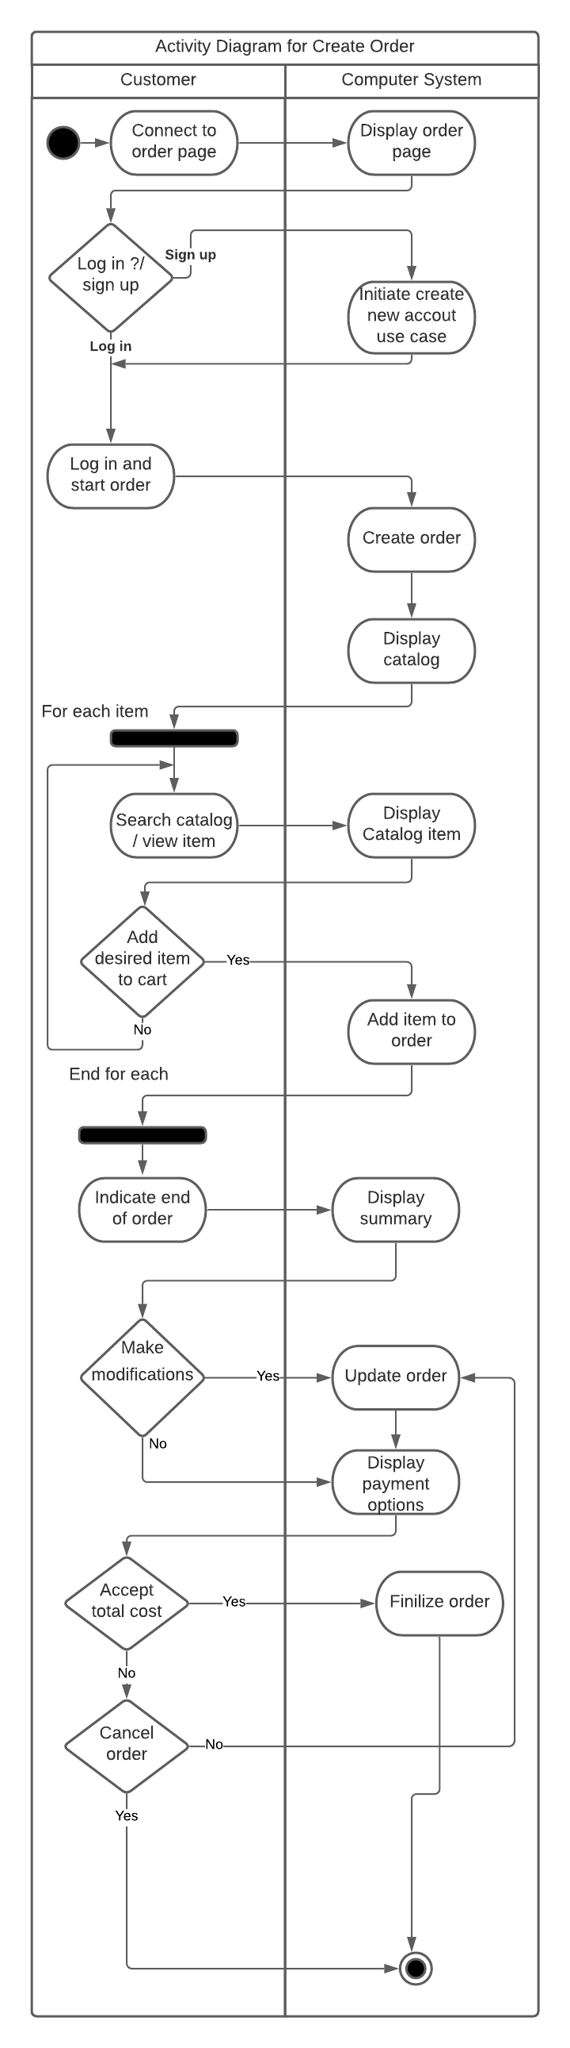
Activity diagram for Create order use case

Slide 22
Scenario for Create account use case
Use Case Name: | Create account
Actor: | Customer
Preconditions: | ----------------------
Postconditions: | System issues email to customer with new account ID and data
Flow of activities: | Actor | System
 | 1. Customer requests to create account. 2. Customer enters his/her name, phone number and email. 3. Customer enters his/her address 4. Customer chooses payment method | 1. System creates a new account 1.2 System prompts for customer data 2.1 System verifies customer data 2.2 System prompts for customer address 3.1 System verifies customer address 3.2 System prompts for credit/debit card information or payment on delivery . 4.1 System verifies credit/debit card authorization. 4.2 System returns valid customer account details.
Exceptions | 2.1 If customer data is incorrect then the system prompts customer for entering correct data. 3.1 If customer address is incorrect then the system prompts customer to enter the correct address. 4.1 if credit/debit card information is incorrect then system a. prompts for correct credit/debit card information, or b. suggests payment on delivery.

Slide 23
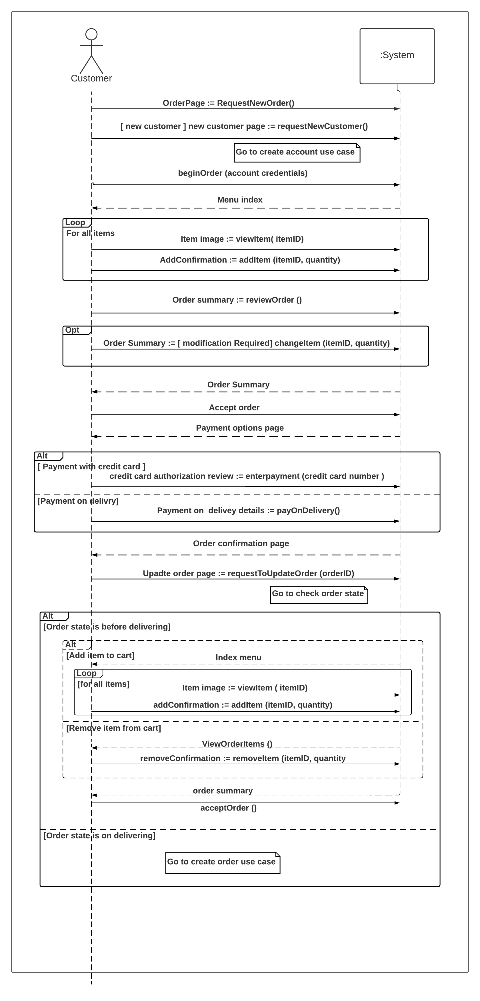
Sequence diagram for Order entry subsystem

Slide 24
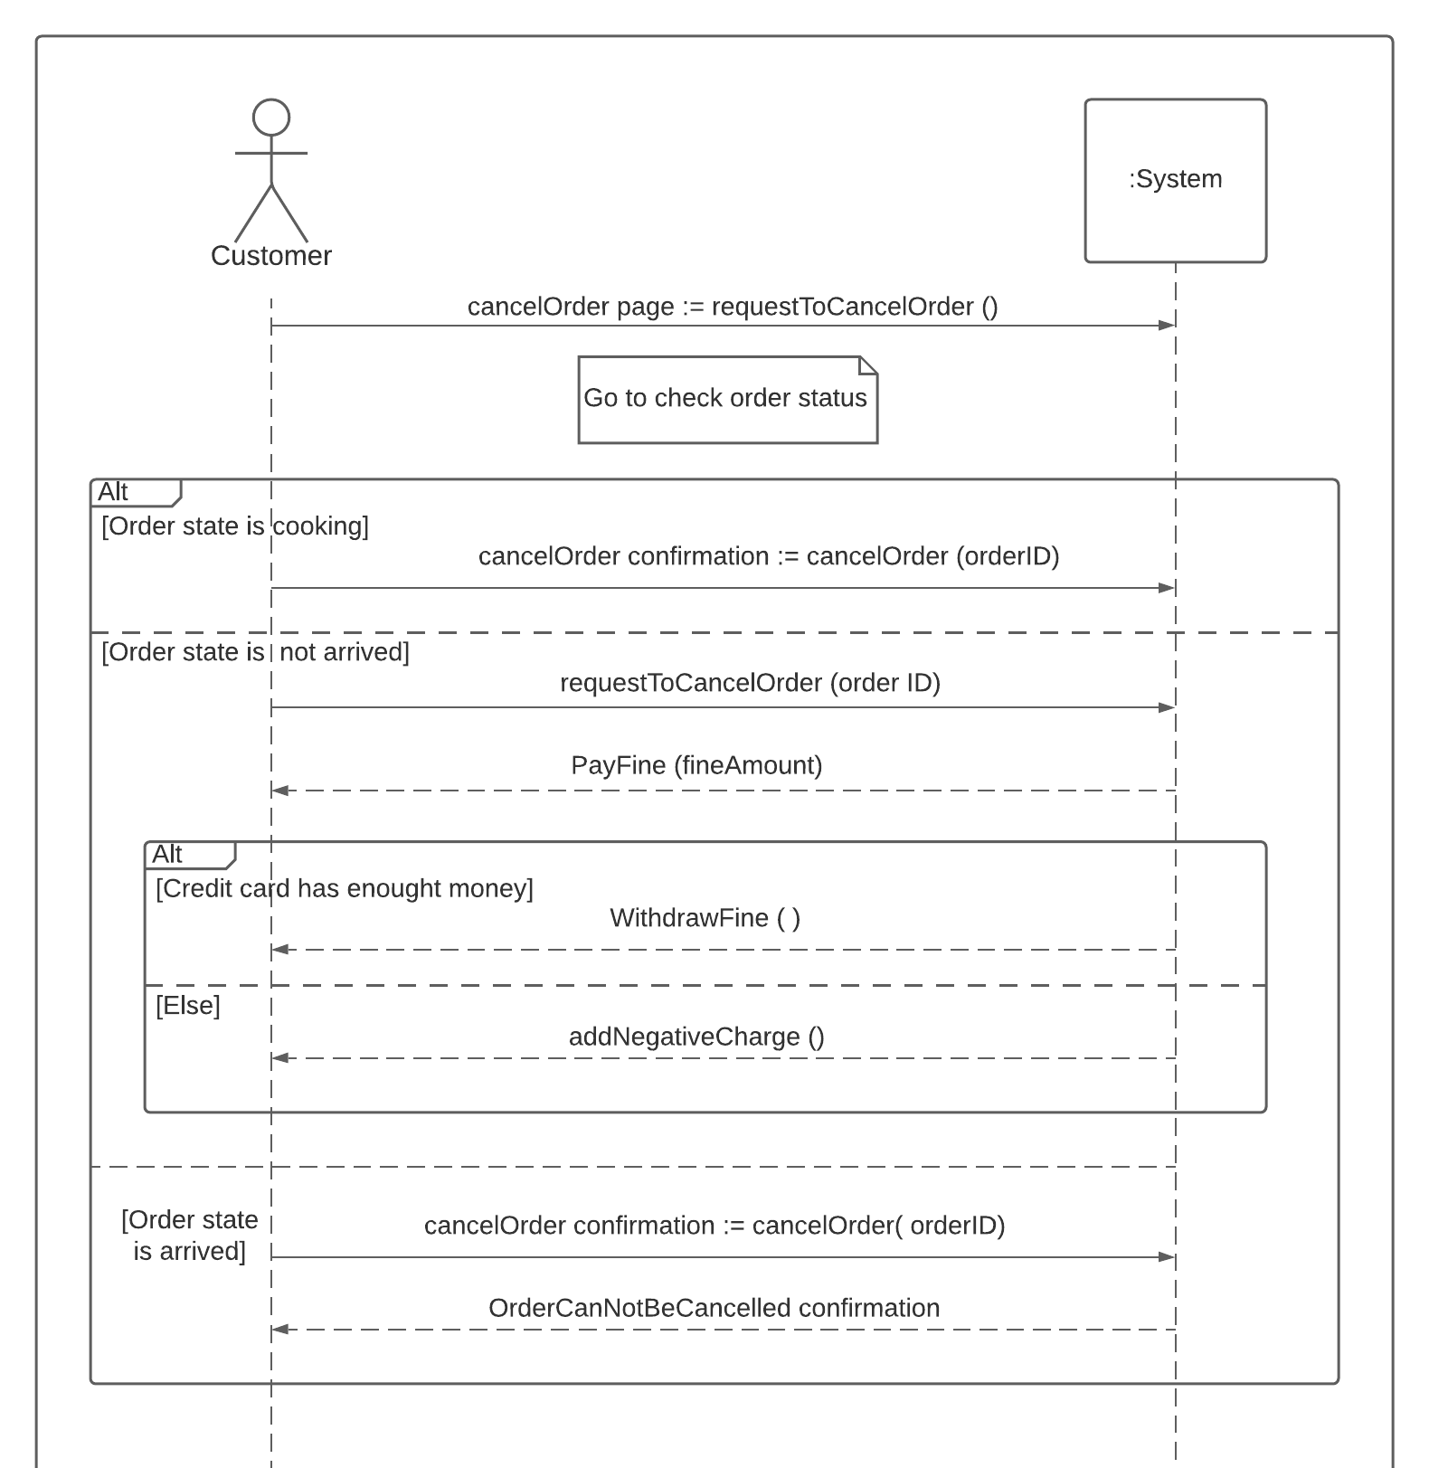
Sequence diagram for Order entry subsystem

Slide 25
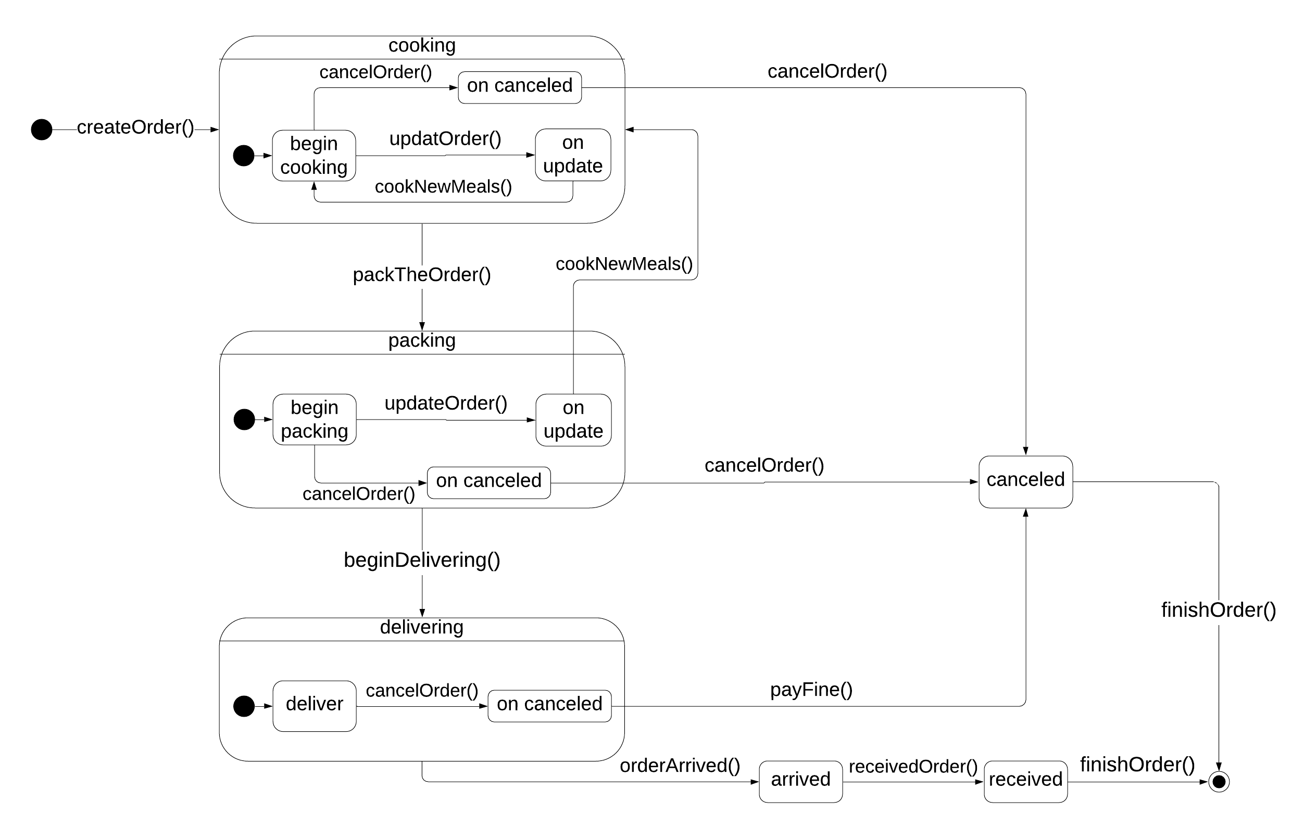
State machine for Order object

Slide 26
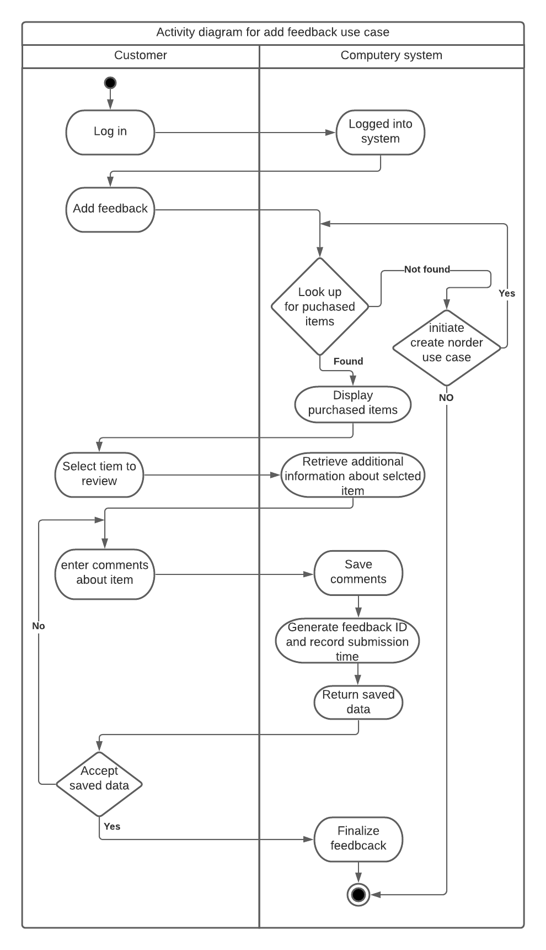
Activity diagram for Add feedback use case

Slide 27
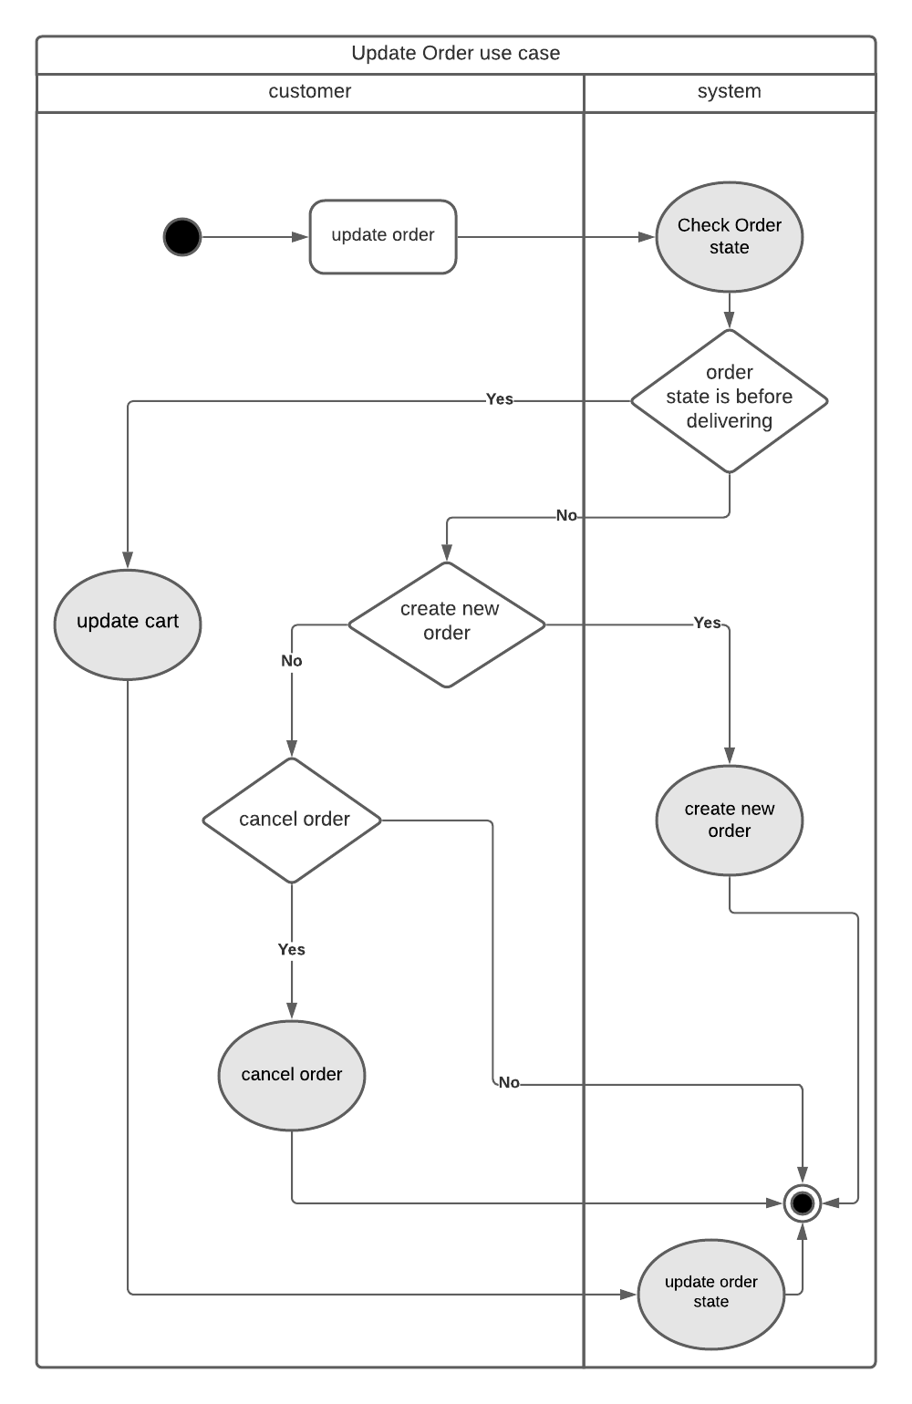
Activity diagram for Update order use case

Slide 28
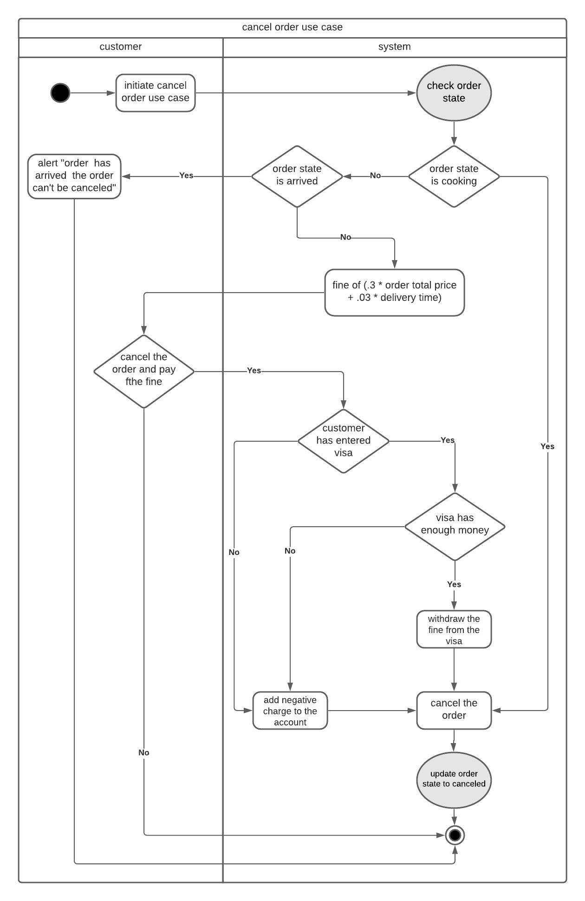
Activity Diagram for Cancel order use case

Slide 29
Scenario for Add meal use case
Use case name: | Add meal.
Actors: | Admin.
Precondition: | Meal is not in menu
Postcondition: | Meal is in menu
Flow of activities: | Actor | System
 | 1. Admin initiates adding a new meal. 2. Admin enters meal name. 3. Admin enters meal description and ingredients. 4. Admin attaches meal’s pictures. 5. Admin verifies returned data. 6. Admin confirm returned data. | 1.1 System adds a new meal. 1.2 System creates a new page for the meal. 1.3 System requests to enter meal name. 2.1 System requests to enter meal description and ingredients. 3.1 System requests to attach meal’s pictures. 4.1 System returns valid data to confirm. 6.1 System receive confirmation 6.2 System finishes add new me.
Exception conditions: | 1.1 If the meal name is already on the website, then the system notify the admin to Change the name of the meal. 1.2 if the meal was in the database of the site and was removed before then a. the data about the meal can be reinserted by system, or b. admin insert new data about the meal. 5.1 if Admin wants to change some details of the meal then he can update the description of the meal.

Slide 30
Scenario for Update meal use case
Use case name: | Update meal description.
Actors: | Admin.
Precondition: | Meal is existing in menu.
Postcondition: | None.
Flow of activities: | Actor | System
 | 1. Admin starts to update a meal. 2. Admin selects a meal from the menu to update. 3. Admin checks meal name to update 4. Admin checks meal description to update. 5. Admin checks meal picture to update. 6. Admin check meal price to update 7. Admin acknowledging finishing updating. 8. Admin verifies returned valid data. 9. Admin confirms all updates | 1.1 System starts updating a meal. 1.2 System displays menu. 2.1 System display all details about the selected meal 3.1 System updates meal name. 4.1 System updates meal description. 5.1 System updates the meal picture. 5.1 System returns valid data to confirm updates. 6.1 System updates meal price 7.1 System returns all updated data to confirm 9.1 System finishes updating data.
Exception conditions: | 3.1 If the admin does want to update the meal name then he leaves it as it is. 4.1 If the admin does want to update the meal description then he leaves it as it is. 5.1 If the admin does want to update the meal picture then he leaves it as it is 6.1 If the admin does want to update the meal price then he leaves it as it is. 8.1 if admin refuses returned data, then Admin can apport the updating process and changes won’t apply, or Admin can change the inserted data.

Slide 31
Scenario for Delete meal use case
Use case name: | Delete Meal.
Actors: | Admin.
Precondition: | Meal is existing in menu.
Postcondition: | None.
Flow of activities: | Actor | System
 | 1. Admin initiates desire to delete a meal 2. Admin selects a meal to remove from the menu. 3. Admin confirms removing the meal. | 1.1 System starts deleting a meal. 1.2 System displays the menu. 2.1 System returns confirmation for removing the meal. 3.1 System receives confirmation. 3.2 System removes the meal and keeps data related to the meal in the database.
Exception conditions:

Slide 32
Scenario for Add new offer use case
Use case name: | Add new offer.
Actors: | Admin.
Precondition: | 1.The offer should be added to an existing meal.
Postcondition: | 1.The offer is terminated by the system after a time assigned by the admin.
Flow of activities: | Actor | System
 | 1. Admin selects a meal for adding an offer to the meal. 2. Admin enters the discount percentage. 3. Admin enters the duration of the offer. 4. Admin verifies returned valid data. 5. Admin confirm valid data. | 1.1 System starts to add an offer for the meal. 2.1 System adds the discount to the meal’s prince showing the customer the normal price and the offered one. 3.1 System adds duration to the offer and shows the remaining time of the offer until canceling the offer. 3.2 System return valid data for confirmation. 5.1 System receives confirmation. 5.2 System finishes adding offer.
Exception conditions: | 1.if the offer is added to non existing meal, then a.the system notify the admin that the offer can’t be applied. 4.1 if admin refuses the returned data,then admin can terminate the process. admin can change the inserted data.

Slide 33
Scenario for Look up for meal use case
Use case name | Look up for meal
Actor | Customer
Preconditions | keywords entered Search button pressed
Postcoditions | Find meal or not
Main activity flow | actor | system
 | 1-customer enters search meal | 1.1-system receives keywords meal 1.2-system searches In meals 1.3-system may find meal 1.4-system requests information meal 1.5-system returns information meal
Exceptions | if customer enters incorrect meal , system display message alerting customer . -if customer enters null, system display message alerting customer .

Slide 34
Scenario for Add item to cart use case
Use Case Name: | Add item to cart.
Actors: | Customer.
Preconditions: | Customer must have an account. Customer account must be logged in.
Post conditions: | item information must be updated. (number of items left in stock). Cart content must be updated.
Flow of activities: | Actor | System
 | Customer wants to add item. Customer adds item to his/her cart. Customer enters number of items to be added. Customer confirms the addition process. | System checks product availability. System prompts for number of items. System verifies number of items left in stock. System updates number of items left in stock. System prompts for confirmation. System returns product description. System returns cart component.
Exception conditions: | If product is out of stock, then customer can Choose not to purchase item. Request item to be added as a back-ordered item. If the number of items is not enough, then customer can Reduce the number of items. Request the rest number as a back-ordered items.

Slide 35
Scenario for Remove item from cart use case
Use Case Name: | Remove item from cart.
Actors: | Customer.
Preconditions: | Customer must have an account. Customer account must be logged in. Customer should provide the number of items will be removed.
Post conditions: | Product information must be updated. (number of items left in stock). Cart content must be updated.
Flow of activities: | Actor | System
 | Customer wants to remove item. Customer removes item to his/her cart. Customer enters number of items to be removed. Customer confirms removal process. | System checks cart content. System prompts for number of items. System updates number of items left in stock. System prompts for confirmation. System returns cart content. System offers recommended similar products.
Exception conditions: | If product is not in the cart, then ask the customer to enter the name correctly. If the number of items to be removed is larger than the number of items in cart, then ask the customer to enter a number less than or equal number of items in the cart.

Slide 36
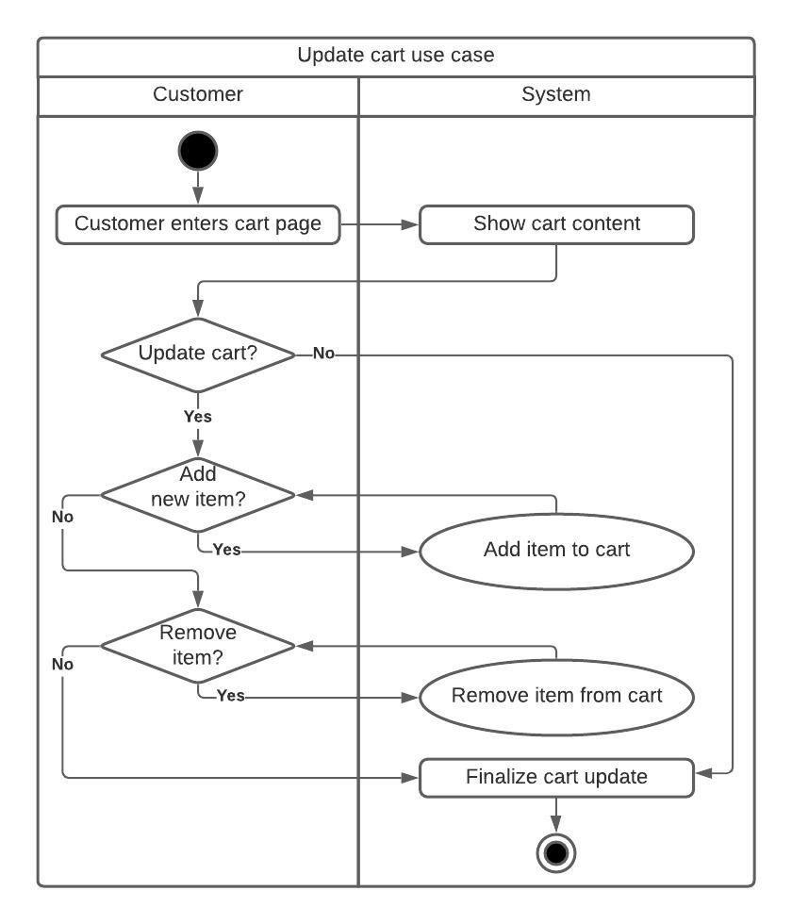
Activity diagram for update cart use case

Slide 37
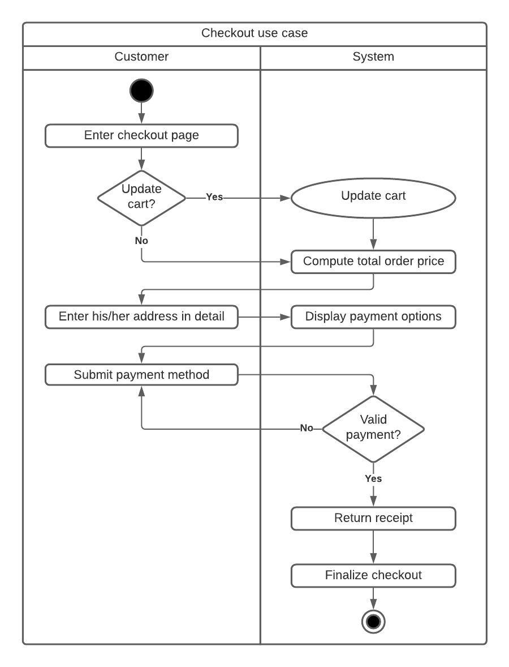
Activity diagram for check out use case

